Slide 1
Office Leave Management System
- Bharath Kumar palasa

Slide 2
Introduction
The Office Leave Management System is a digital tool that enables organizations to manage and track employee leaves effectively. It streamlines the leave application process, eliminates manual errors, and ensures compliance with company policies and regulations.
This system provides a centralized platform for employees to apply for leaves, check their leave balances, view their leave history, and receive approval or rejection notifications in real-time. It also allows managers to review and approve/deny leave requests, and maintain an accurate record of employee attendance.

Slide 3
Benefits of Office Leave Management System
The Office Leave Management System offers numerous benefits to both employers and employees. For instance, it helps to reduce administrative workload and paperwork, which saves time and resources. It also minimizes errors and discrepancies in leave records, which enhances accuracy and accountability.
Moreover, this system promotes transparency and fairness in leave allocation and approval processes. Employees can easily access their leave information and track their balances, while managers can monitor employee attendance and ensure adequate staffing levels. Additionally, it improves communication and collaboration among team members, as everyone can view the same information and updates in real-time.

Slide 4
Features of Office Leave Management System
The Office Leave Management System comes with a range of features designed to simplify and automate leave management processes. These include an online leave application form, leave balance tracking, automated approval workflows, customized leave policies, and real-time notifications.

Slide 5
Technologies :
JAVA – 8
Spring boot
Rest API
My SQL
Spring Data JPA
Spring Security
Jasper Reports
Swagger
Junit
Sonal Qube

Slide 6
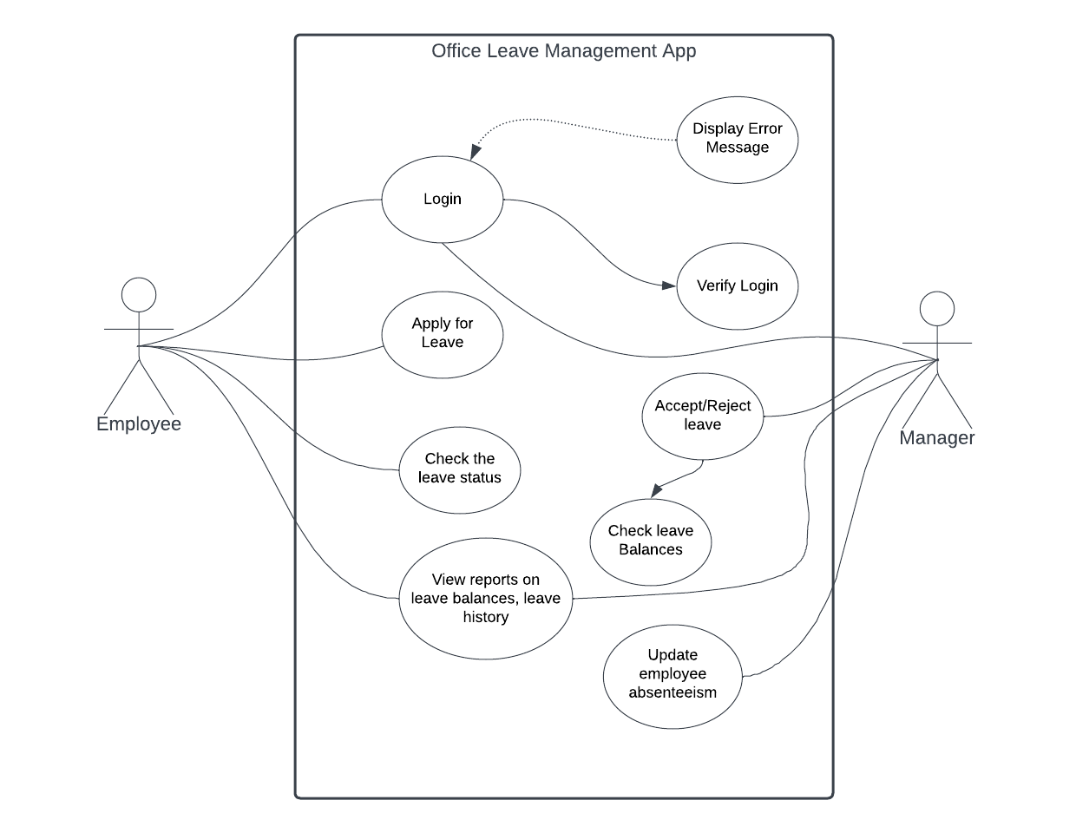
Use Case UML Diagram

Slide 7
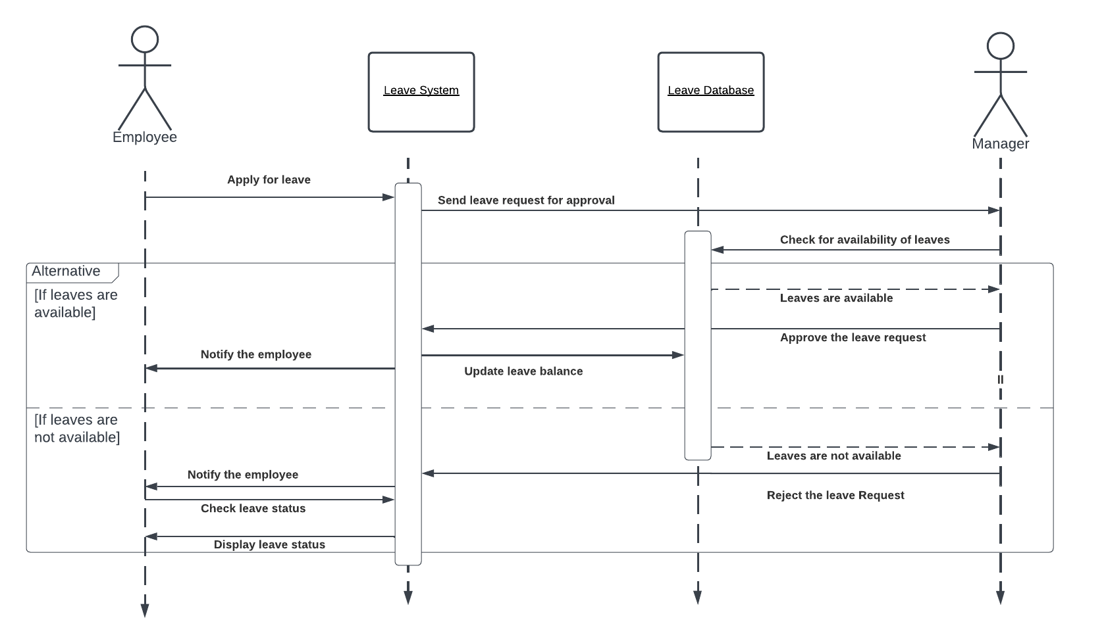
Sequence UML Diagram

Slide 8
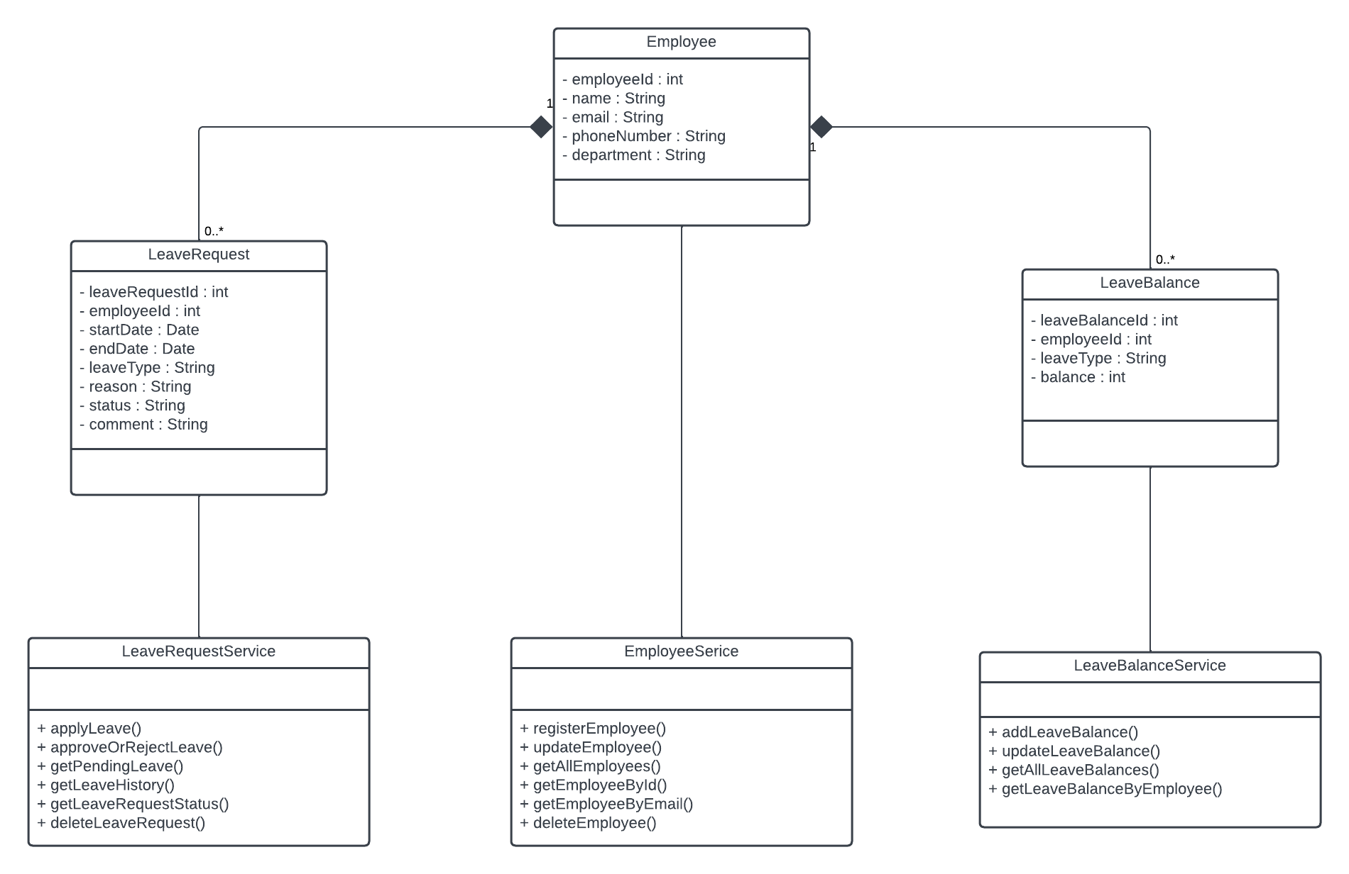
Class UML Diagram

Slide 9
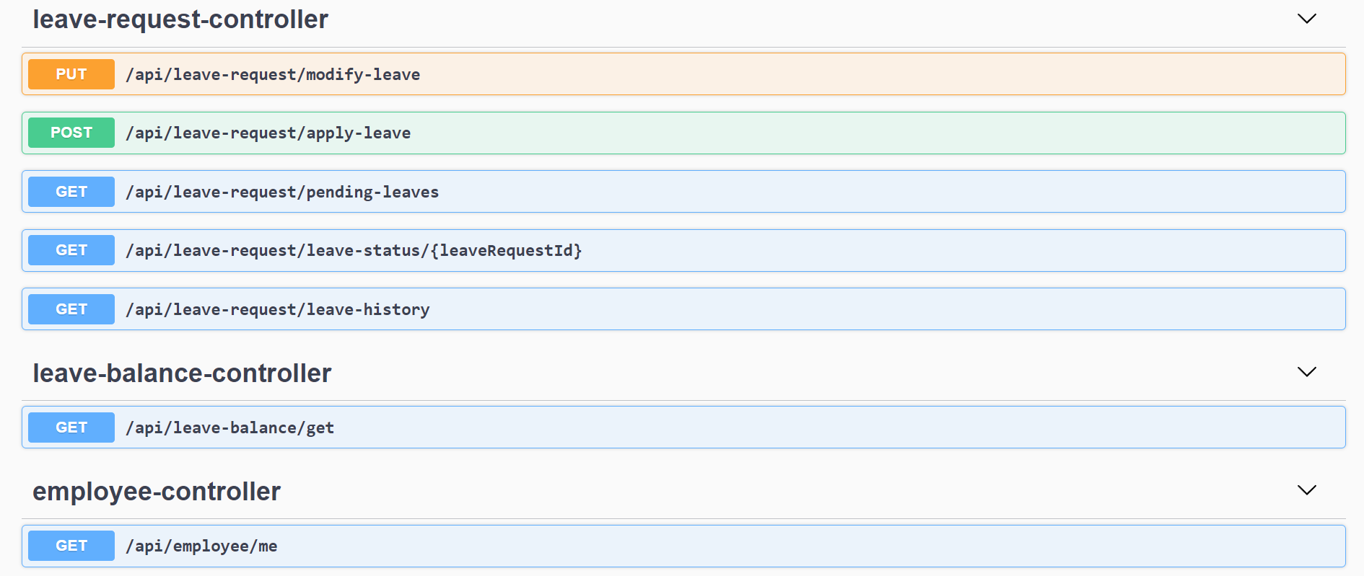
Employee Module

Slide 10
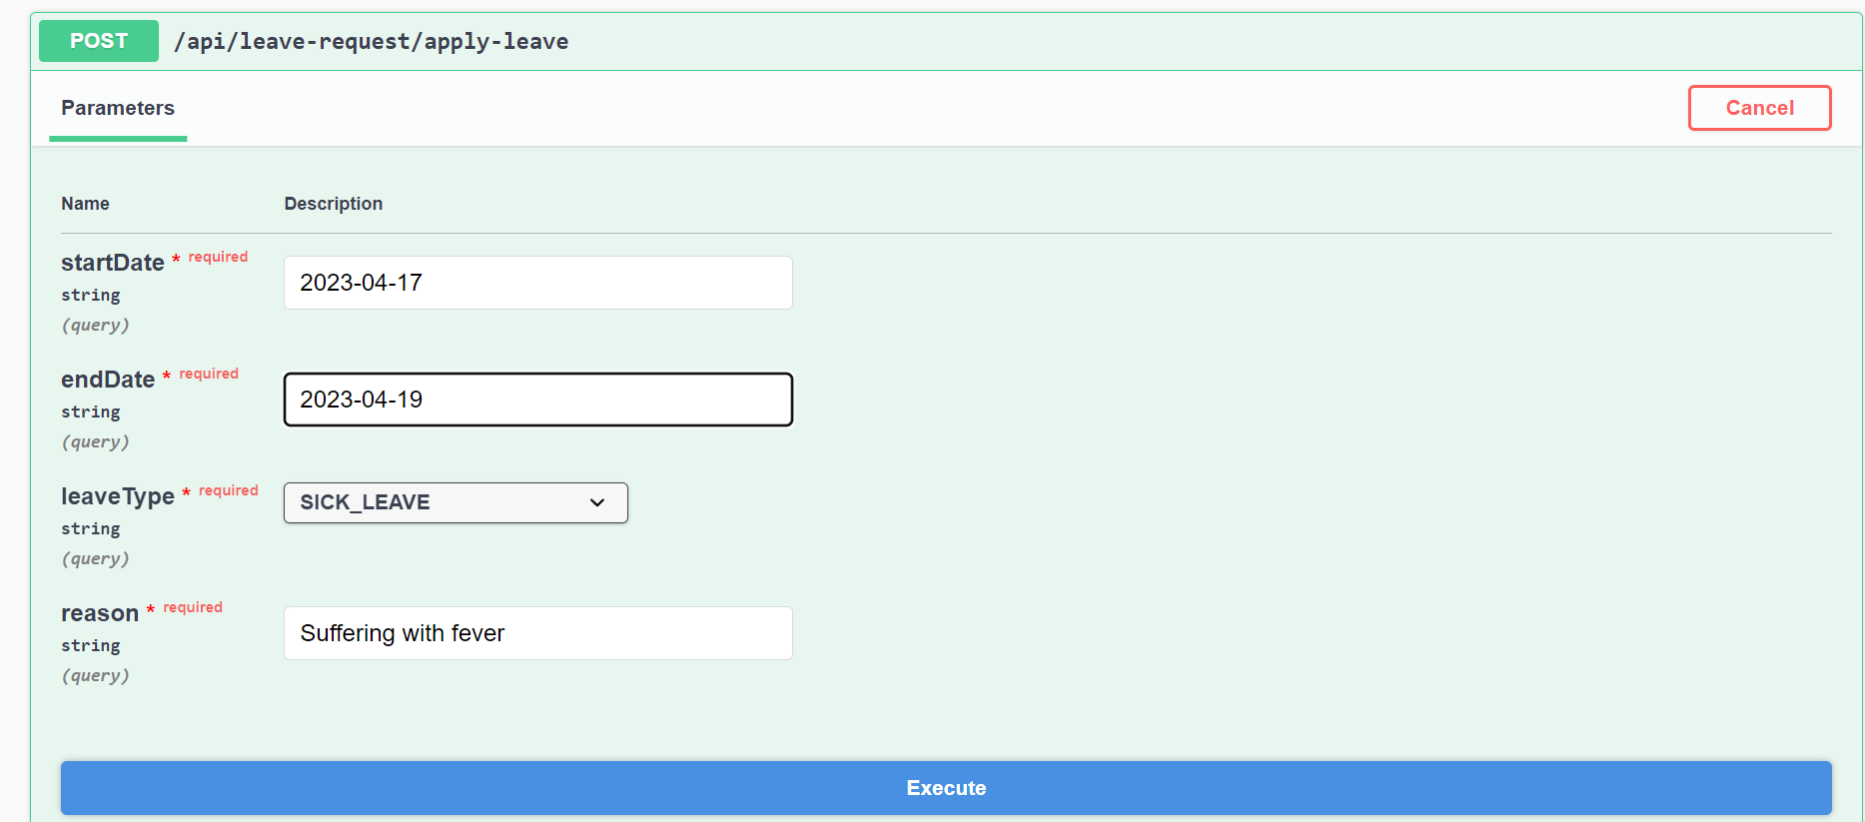
Apply for leave

Slide 11
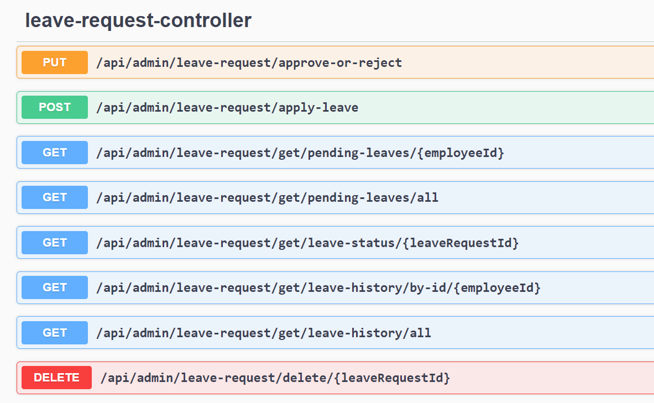
Admin Module

Slide 12
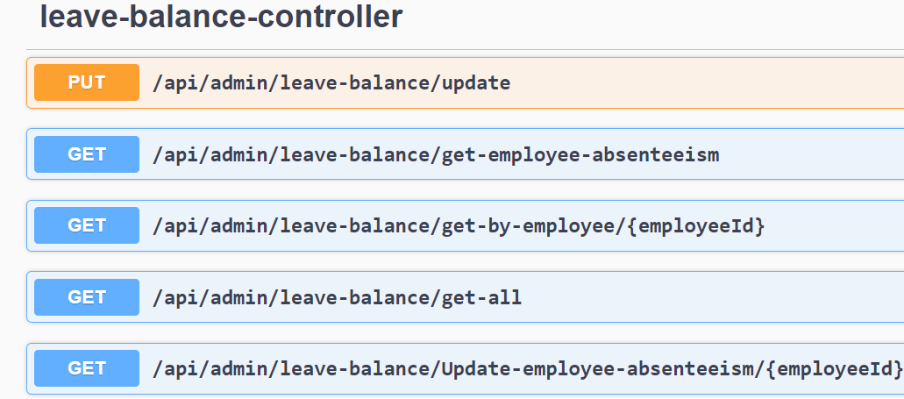
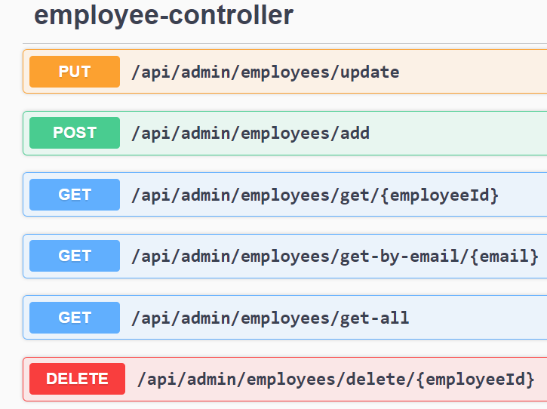
Admin Module

Slide 13
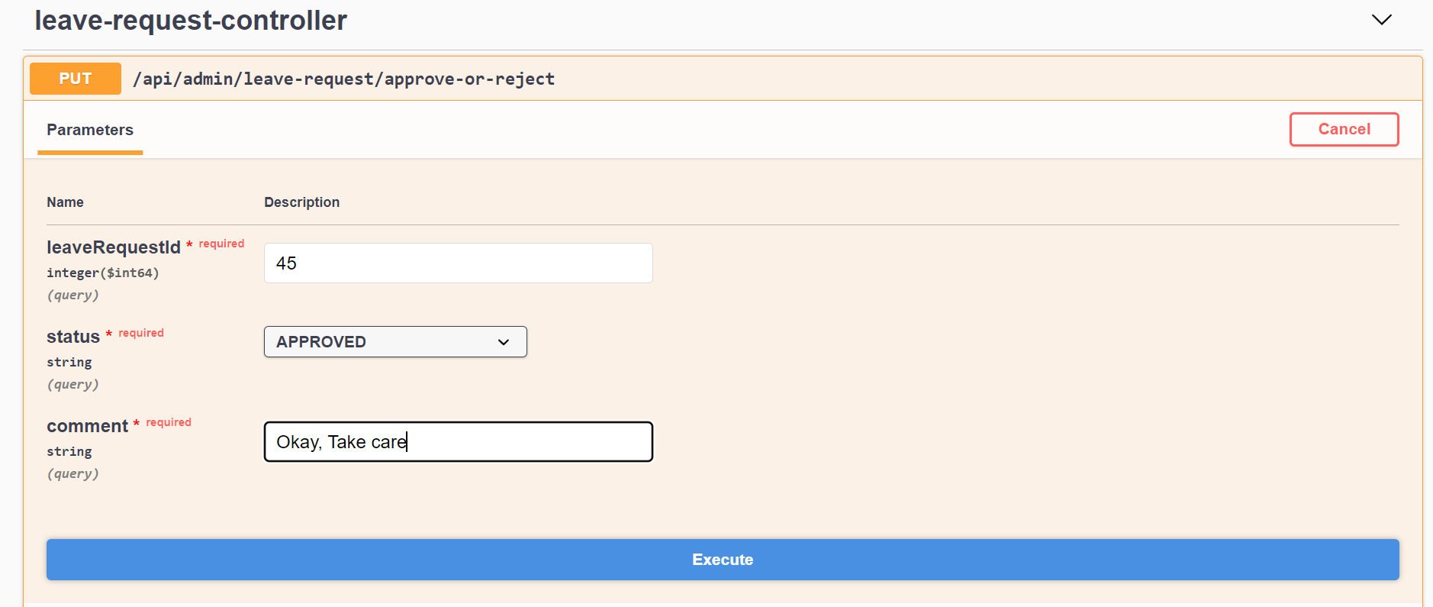
Approve or Reject the Leave

Slide 14
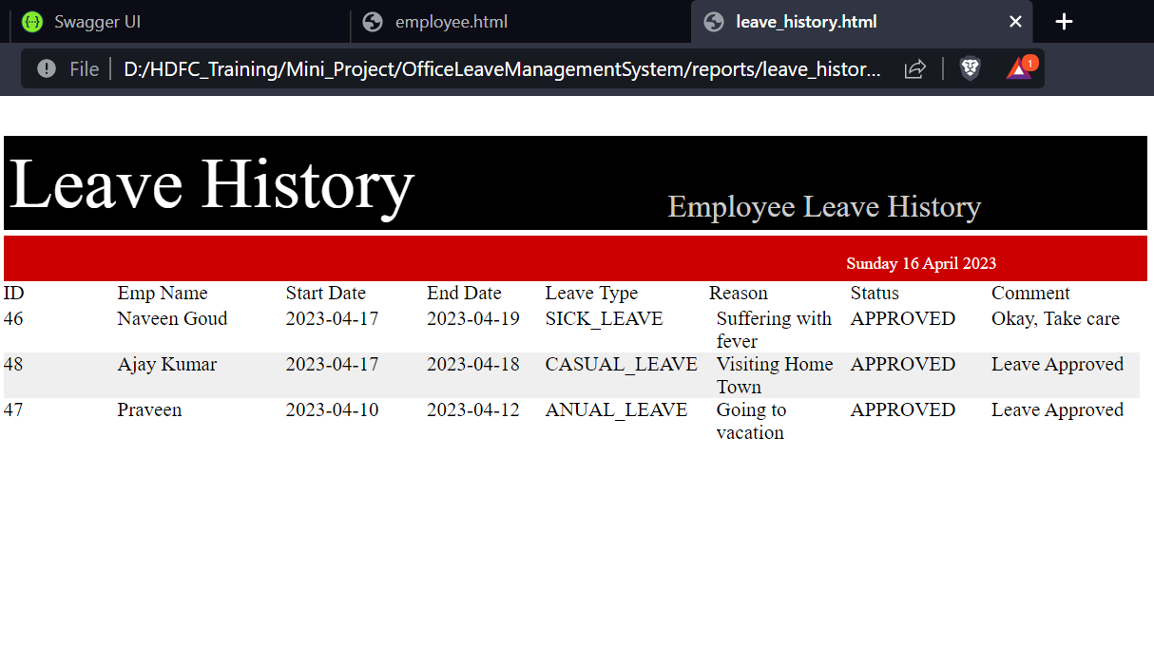
Leave History Report

Slide 15
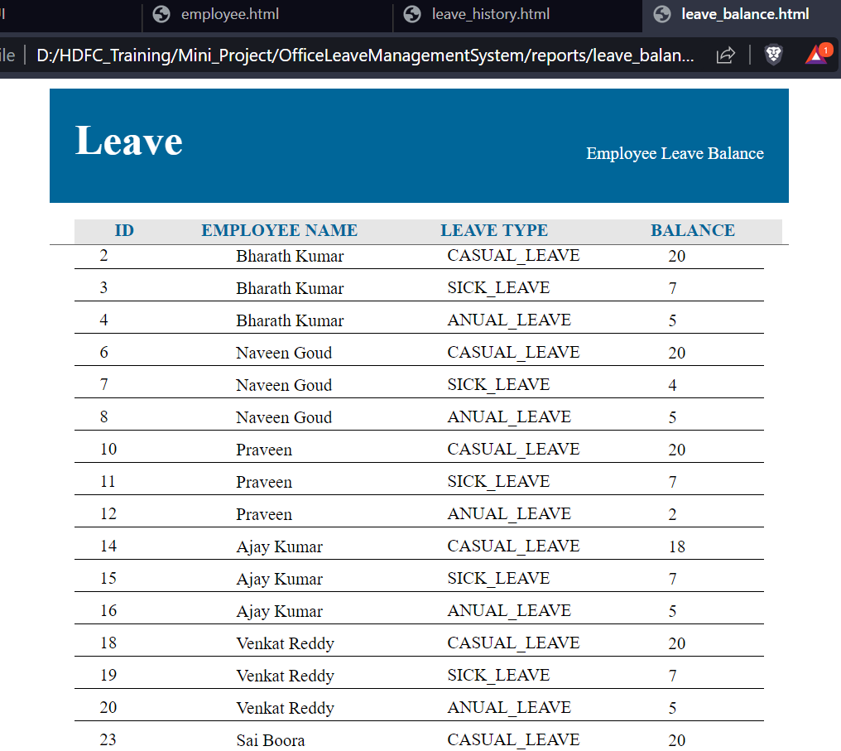
Leave Balance Report

Slide 16
Conclusion
In conclusion, the Office Leave Management System is a crucial tool for modern organizations that want to streamline their leave management processes, enhance productivity, and improve employee satisfaction. It offers numerous benefits, such as automation, accuracy, transparency, and collaboration, and helps to overcome common challenges, such as resistance to change and data privacy concerns.

Slide 17
Thank You

